Slide 1

U P L I F T I N G S O N G

Slide 2
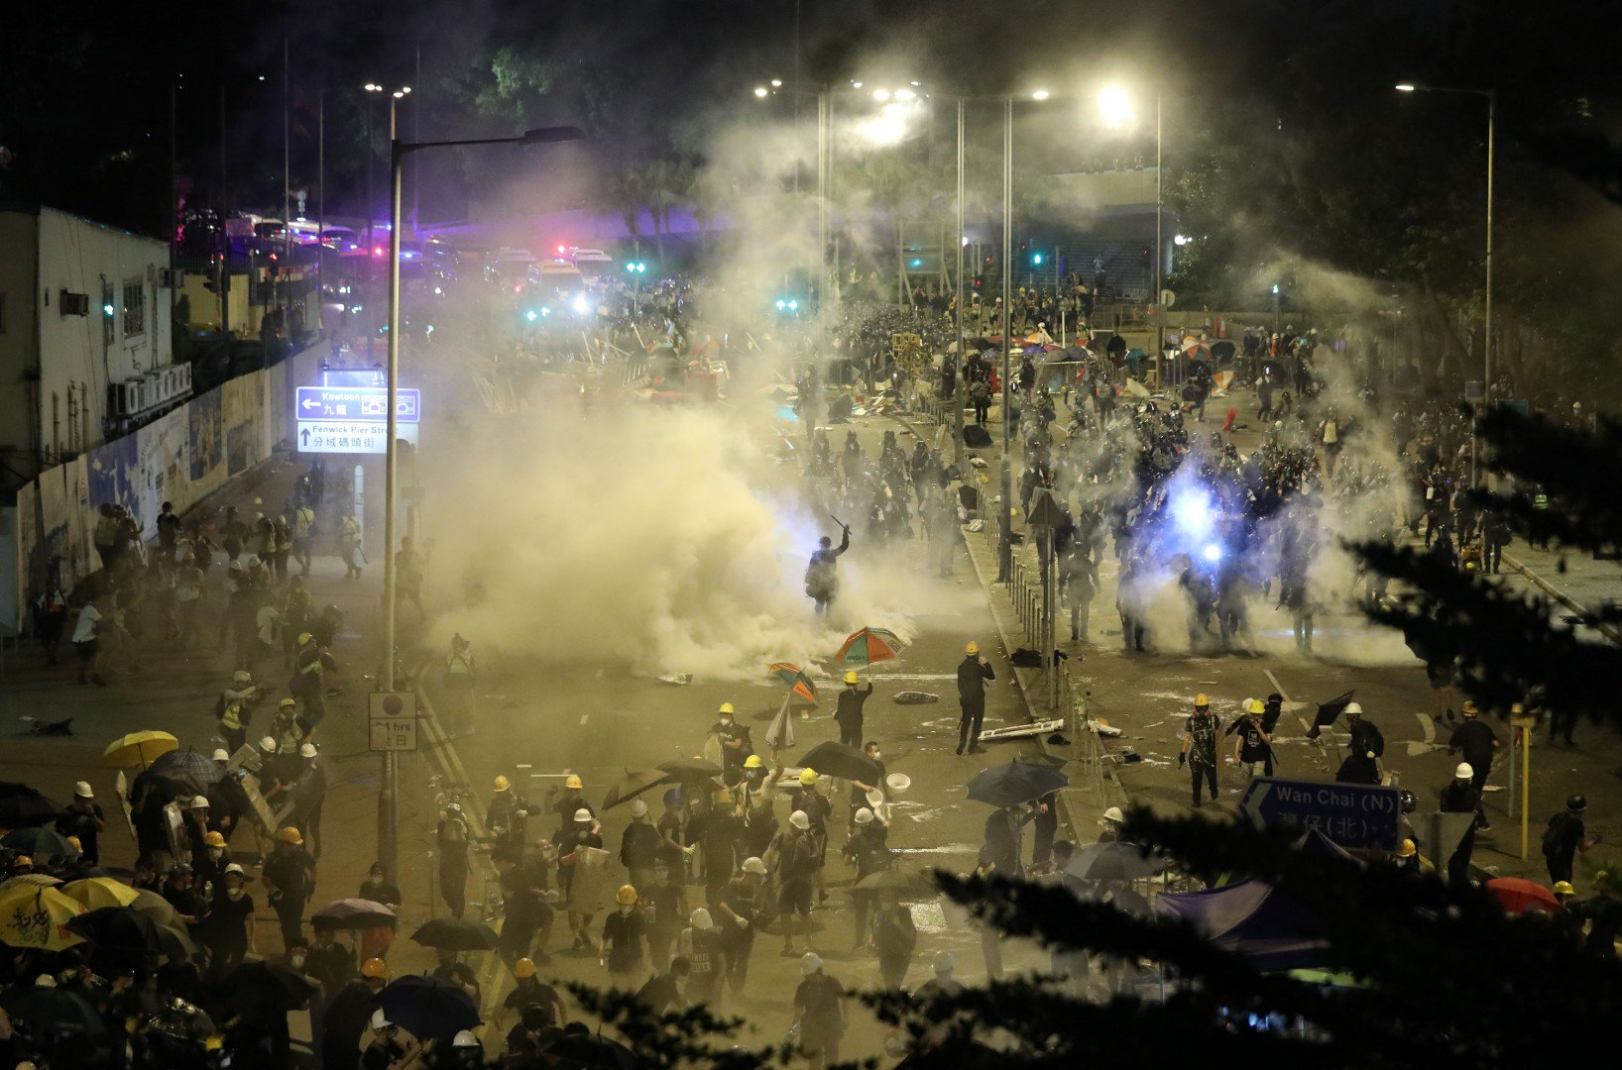
Unprecedented violence
Confrontations between the society and the authorities

Slide 3
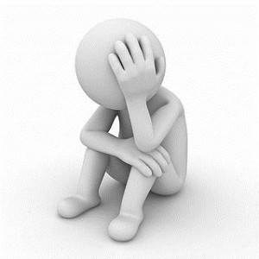
Worry about the future
Be haunted by feelings of disappointment, depression or despair

Slide 4

What can we do to get out of the storm and gloominess?

Slide 5

It’s a dawn – a day that shines with the light of hope.

Slide 6

Don’t dwell on negative thoughts
See hardships through an optimistic lens
Have a stronger will to overcome difficulties

Slide 7

FOR STRENGTH AND RESILIENCE TO FACE ADVERSITY

Slide 8
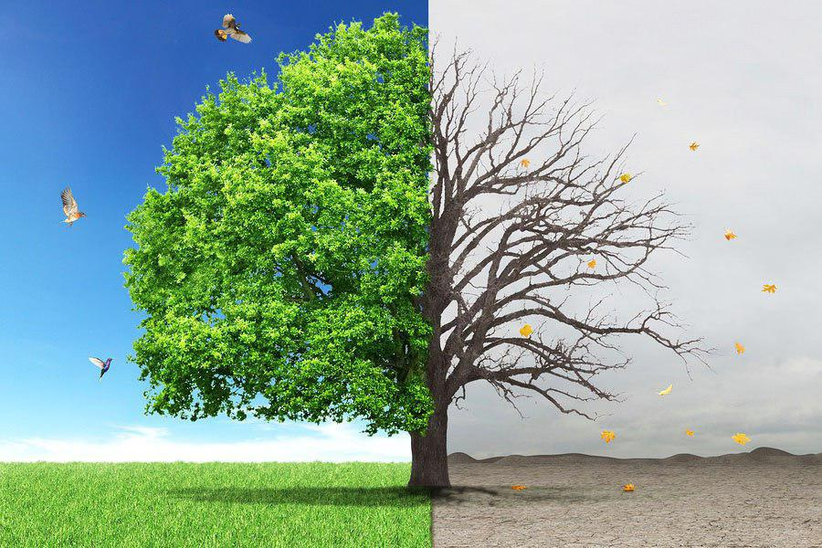
God will turn curses into blessings.

Slide 9


Slide 10

All the promises are ready for you.

